Slide 1
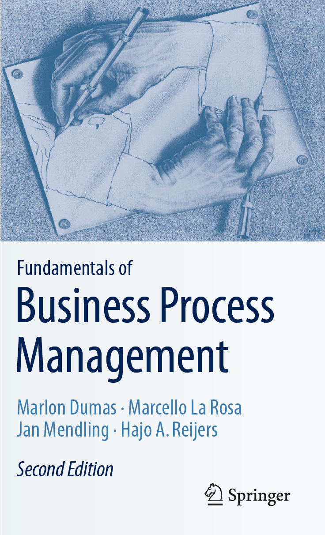
Chapter 8: Process Redesign
Contents
The Essence of Process Redesign
Transactional Methods
Transformational Methods
Recap

Slide 2

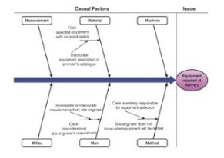
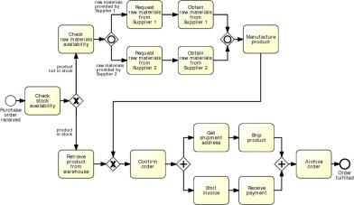
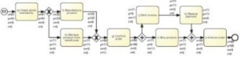
Process Redesign in the BPM Lifecycle

Slide 3
Chapter 7: Quantitative Process Analysis
Contents
The Essence of Process Redesign
Transactional Methods
Transformational Methods
Recap

Slide 4
Motives for Process Redesign
Positive motive:
The urge of organizations to innovate
Reactive motive:
Fight organizational entropy

Slide 5
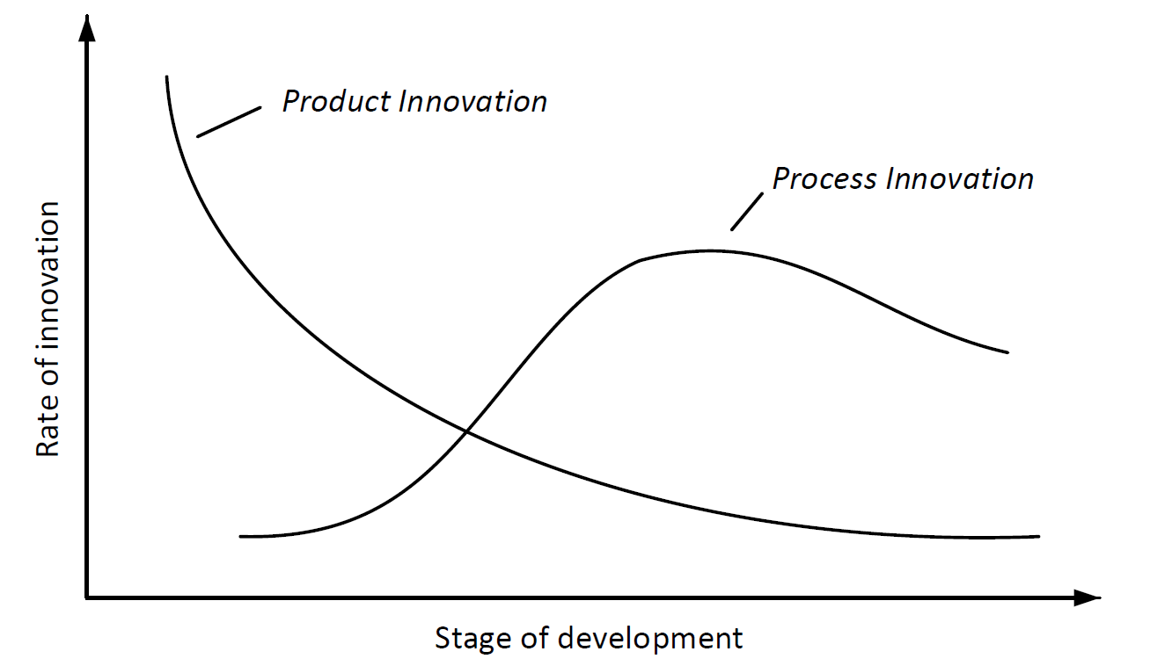
The Abernaty-Utterback Model

Slide 6

Exercise 8.1: Organizational Entropy
Can you identify business processes from your own experience that were efficient at some stage, but which have become unnecessarily complex?

Slide 7
Elements of redesign
the internal or external customers of the business process,
the business process operation view, which relates to how a business process is implemented, specifically the number of activities that are identified in the process and the nature of each, and
the business process behavior view, which relates to the way a business process is executed, specifically the order in which activities are executed and how these are scheduled and assigned for execution,
the organization and the participants in the business process, captured at two levels:
the organization structure (elements: roles, users, groups, departments, etc.), and
the organization population (individuals: agents which can have activities assigned for execution and the relationships between them),
the information that the business process uses or creates,
the technology the business process uses, and
the external environment the process is situated in.

Slide 8
Process Redesign
Is a substantial and intentional change of a business process,
Is primarily concerned with changing the business process itself, covering both its operational and behavioral view,
Extends to changes that are on the interplay between on the one hand the process and on the other the organization or the external environment that the process operates in, the information and technology it employs, as well as the products it delivers to its customers.

Slide 9
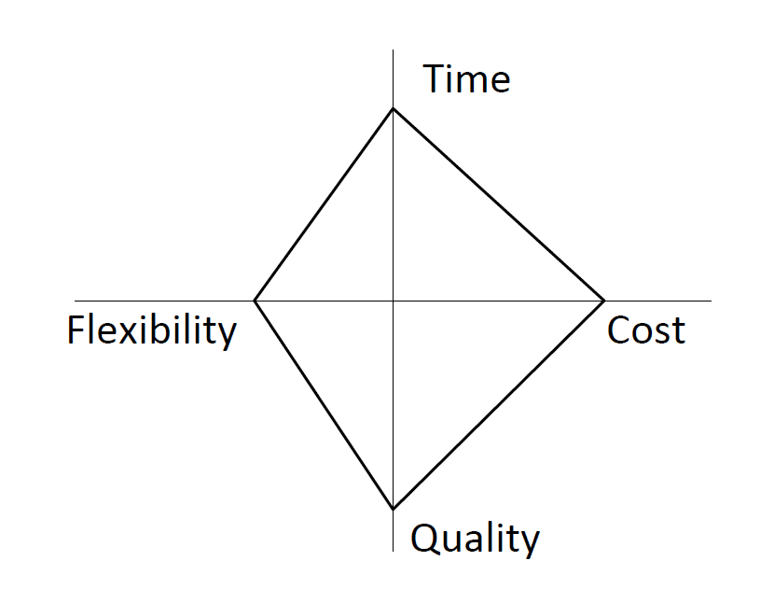
The Devil’s Quadrangle
“improving a process along one dimension may very well weaken its performance along another”

Slide 10
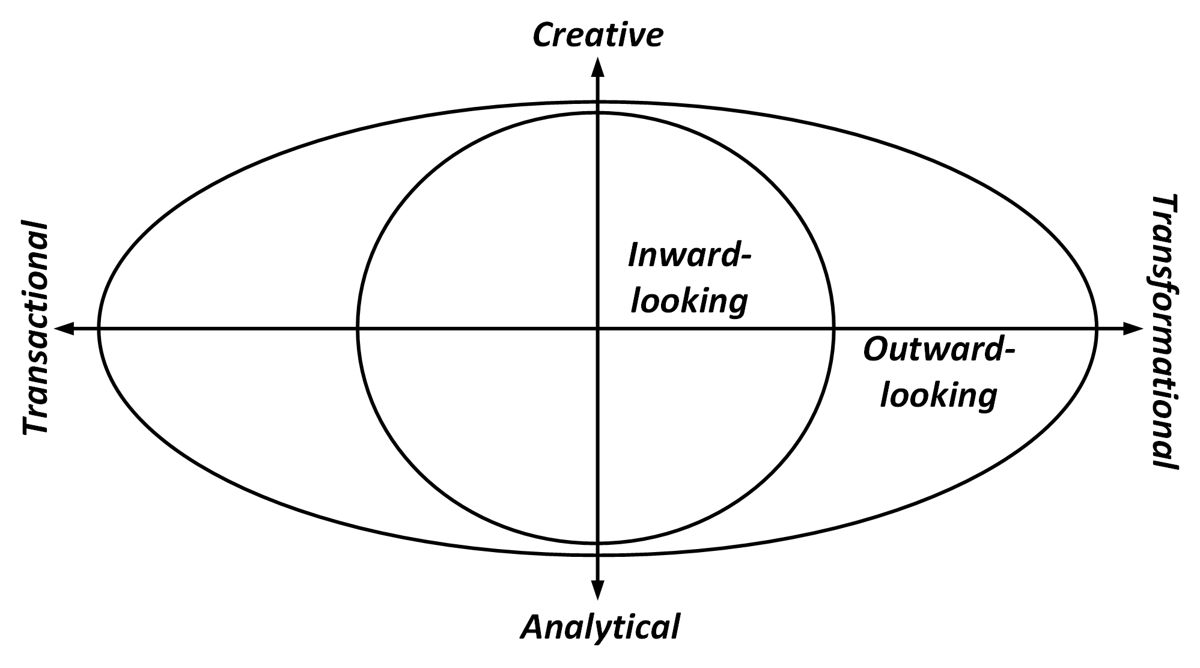
The Redesign Orbit

Slide 11
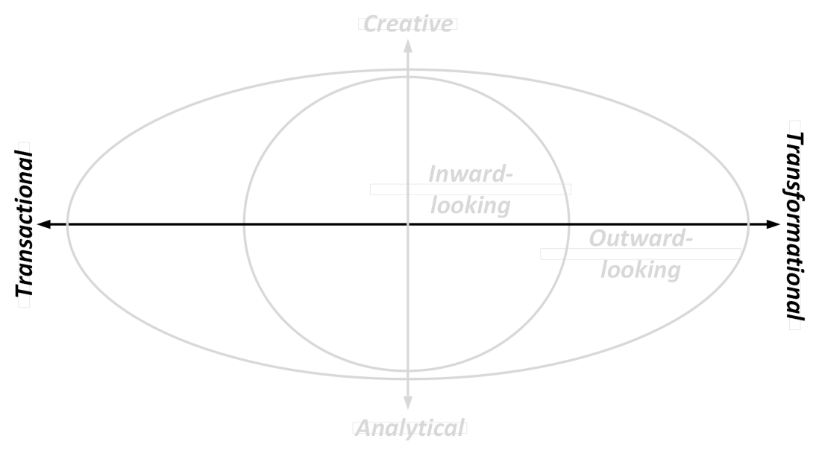
Ambition
Transactional Methods
Seek to identify problems and resolve them incrementally, one step at a time
Do not challenge the current process structure
Transformational Methods
Aim to achieve breakthrough innovation
Put into question the fundamental assumptions and principles of the existing process structure

Slide 12
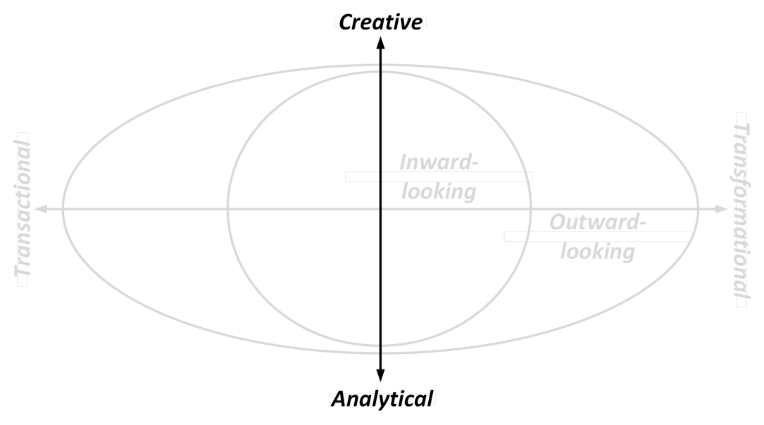
Nature
Analytical Methods
Tend to have a strong mathematical and quantitative focus
Embrace tools and technology
Creative Methods
Rely on human creativity and ingenuity
Embrace group dynamics

Slide 13
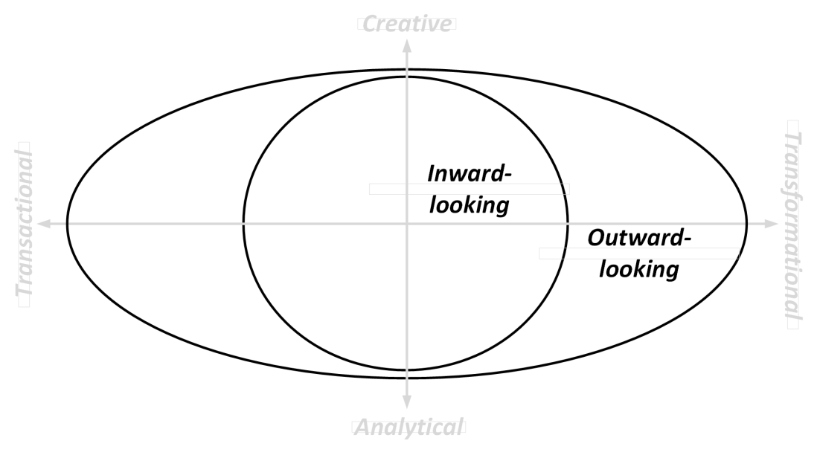
Perspective
Inward-looking Methods
Consider the process from the perspective of the internal organization
Draw from objectives and performance measurement
Outward-looking Methods
Consider the process from an outsider’s perspective
Are driven by external opportunities and developments

Slide 14
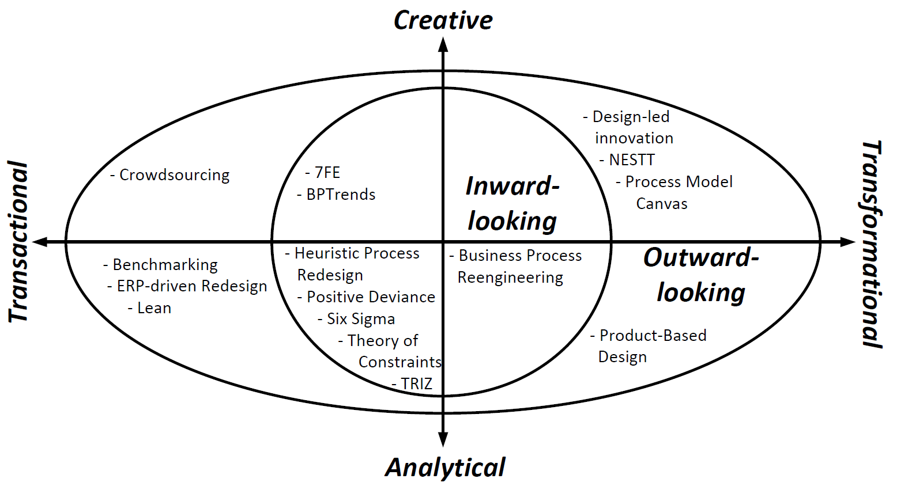
The Redesign Orbit

Slide 15
Chapter 8: Process Redesign
Contents
The Essence of Process Redesign
Transactional Methods
Transformational Methods
Recap

Slide 16
Transactional Methods
Analytical:
employ all kinds of tools, involve statistics, and are strongly rationalized
Inward-looking
Six Sigma
Theory of Constraints
TRIZ
Positive Deviance
Heuristic Process Redesign
strongly focus on the existing process in an organization as a starting point
Outward-looking
Benchmarking
ERP-driven Redesign
Lean
fundamentally outward-looking by taking an external perspective on process redesign

Slide 17
Transactional Methods
Creative:
unleashing the creativity of people
Inward-looking
7FE
BPTrends
emphasis on engaging professionals that already play a role within a targeted business process
Outward-looking
Crowdsourcing
tapping into the skills and knowledge of people outside their organizational borders

Slide 18

7FE
https://www.managementbyprocess.com/

Slide 19
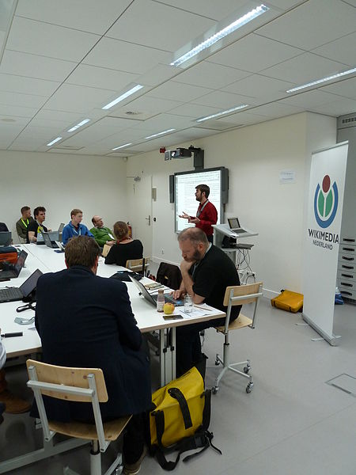
7FE
Facilitators:
Need to ask lots of “what if” and “why this” questions,
Should not accept what he is or she is told (the first time),
Must look for the second ‘right’ answer,
Will regularly change the question and come it at from a different direction,
Shall challenge the rules of the process,
Need to rely on intuition.

Slide 20
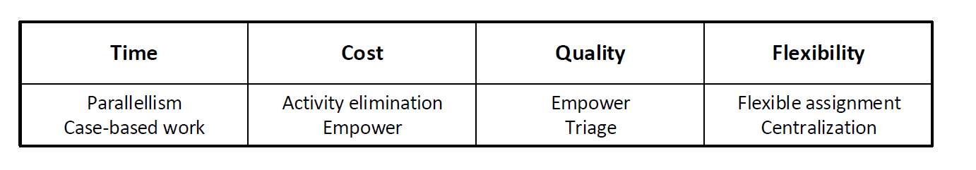
Heuristic Process Redesign
Uses a fixed list of redesign heuristics to determine potential improvement actions on an existing process.
For each of the set performance goals, redesign team reflects on relevant heuristics that may be applied: A redesign heuristic is desirable to apply if it helps to attain the desired performance improvement of the process under consideration.
Applicable and desirable redesign heuristics are clustered
On basis of these clusters, a set of scenarios can be generated, each of which describes which redesign heuristics are applied in this scenario and, importantly, how this is done.

Slide 21
Example Heuristics for Time
Parallelism: “Put activities in parallel”. Activities in a business process are often ordered in a strictly sequential way even though there is no good reason for doing so. Some activities may well be carried out in an arbitrary order or even simultaneously. By allowing a less restrictive choice on the order in which activities are executed, a business process can be carried out faster.
Case-based work: “Remove batch-processing and periodic activities”. Notable sources of delays in business processes exist where individual cases:
get piled up in a batch that is only processed once all its items are available, or
are slowed down by periodic triggers, e.g., a computer system is only available at one specific slot during the day.
Getting rid of such constraints is in general a good way to significantly speed up a process.

Slide 22
Example Heuristics for Cost
Activity elimination: “Eliminate unnecessary activities”. Over time, processes get clogged up with activities that were useful at some point but have lost their purpose or rationale. Control activities, i.e., activities that are incorporated in a process to fix problems, are prime examples of non-value adding activities. Getting rid of unnecessary activities is an effective way to reduce the cost of handling a case.
Empower: “Give workers decision-making authority”. In traditional settings, people have to authorize the outcomes of activities that have been performed by others. If workers are empowered to take decisions autonomously, this may render much of the work of middle managers superfluous, in this way reducing cost significantly.

Slide 23
Example heuristics for Quality
Triage: “Split an activity into alternative versions”. By creating alternative versions of an activity, it is possible to better deal with the variety of cases that need to be processed. An alternative activity essentially pursues the high-level goal of the original activity but is either geared specifically to a sub-category of cases that are being encountered (e.g., orders of special customers vs. all customers) or exploits the characteristics of the resource class that is assigned to it (e.g., senior clerks vs. all clerks). By aligning work more specifically to the properties of particular cases, the quality of work delivered improves.
Case assignment: “Let participants perform as many steps as possible ”. If someone carries out an activity, then that person becomes acquainted at some level with the case for which the work is done. That knowledge accumulates with each activity that is done for the same case. By making one participant the preferred resource for any work that needs to be carried out for a particular case, this knowledge can be leveraged to deliver a high standard of work.

Slide 24
Example Heuristics for Flexibility
Flexible assignment: “Keep generic participants free for as long as possible”. Suppose that an activity can be executed by either of two available participants, then it should be assigned to the most specialized person. In this way, the likelihood to commit the free, more general participant to another work package is maximal. The advantage of this heuristic is that an organization stays flexible with respect to assigning work.
Centralization: “Let geographically dispersed resources act as if they are centralized”. This heuristic is explicitly aimed at exploiting the benefits of a Business Process Management System (BPMS). After all, if a BPMS takes care of assigning work to process participants it becomes less relevant where these resources are located geographically. In this way, resources can be committed more flexibly.

Slide 25

Exercise 8.9: Negative Effects
In recognition of the Devil’s Quadrangle, each heuristic can also have negative side-effects when applied. Can you imagine what negative impact the Frequenz redesign scenario may have on the performance of the rental car collection process in terms of Cost and Flexibility?

Slide 26
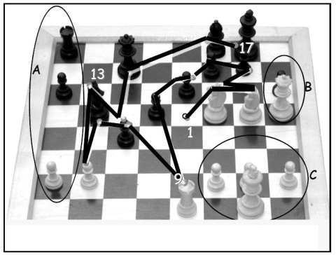
Full Set of Redesign Heuristics
Control relocation
Contact reduction
Integration
Case types
Activity elimination
Case-based work
Triage
Activity composition
Resequencing
Parallelism
Knock-out
Exception
Case assignment
Flexible assignment
Centralization
Split responsibilities
Customer teams
Numerical involvement
Case manager
Extra resources
Specialist-generalist
Empower
Control addition
Buffering
Activity automation
Integral technology
Trusted party
Outsourcing
Interfacing

Slide 27
Chapter 8: Process Redesign
Contents
The Essence of Process Redesign
Transactional Methods
Transformational Methods
Recap

Slide 28
The Redesign Orbit
empty

Slide 29

Transformational Methods
Creative: unleashing the creativity of people
Design-led Innovation:
aims to provide organizations with an understanding of the deep emotional ties that consumers develop with their products.
Its basic tenet is that people are not only served by the form and function of a product, but also through the experience its usage invokes.
Based on this understanding, organizations may pursue innovations that customers do not expect, but which they eventually grow passionate about.

Slide 30
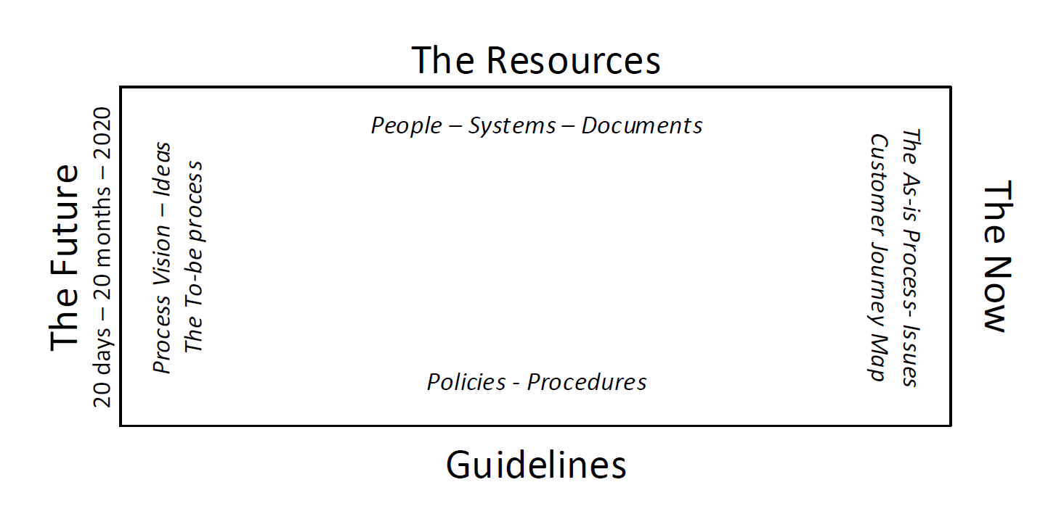
Transformational Methods
Creative: unleashing the creativity of people
NESTT: Navigate, Expand, Strengthen, and Tune/Take-off.
Its defining feature is how participants in a workshop setting use the spatial affordances of a dedicated room.

Slide 31
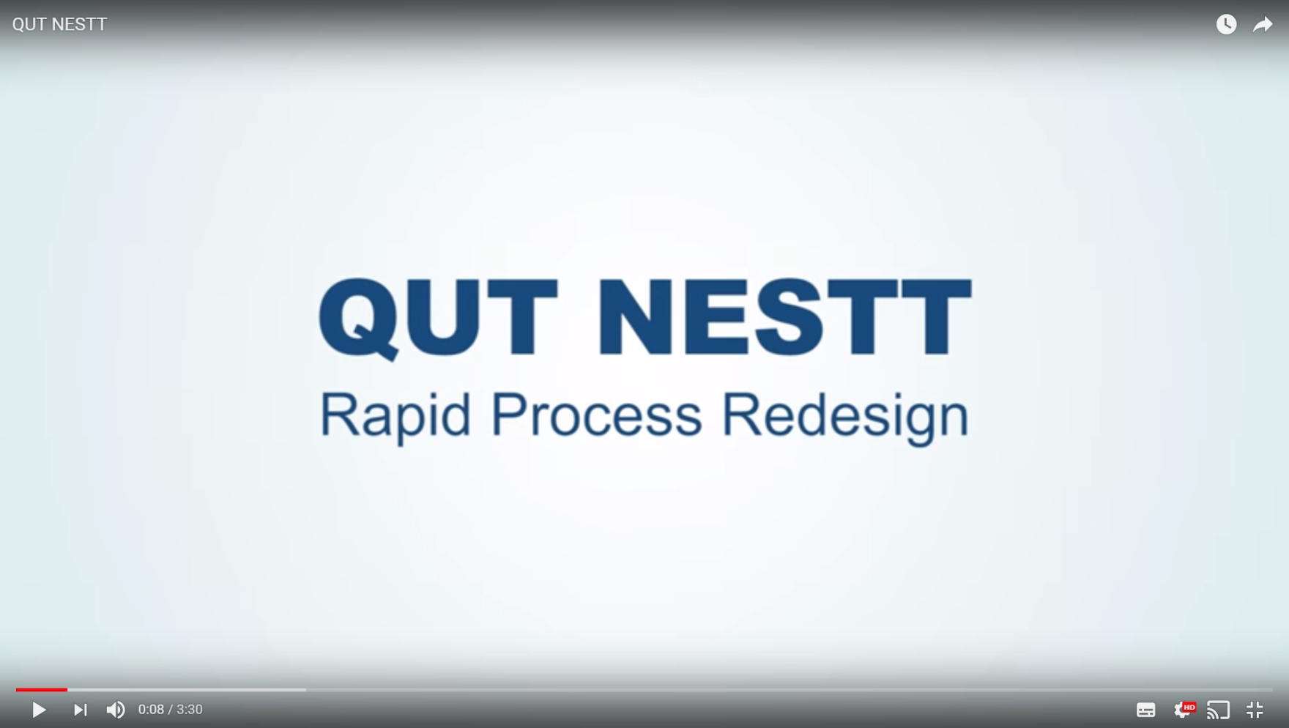
NESTT

Slide 32
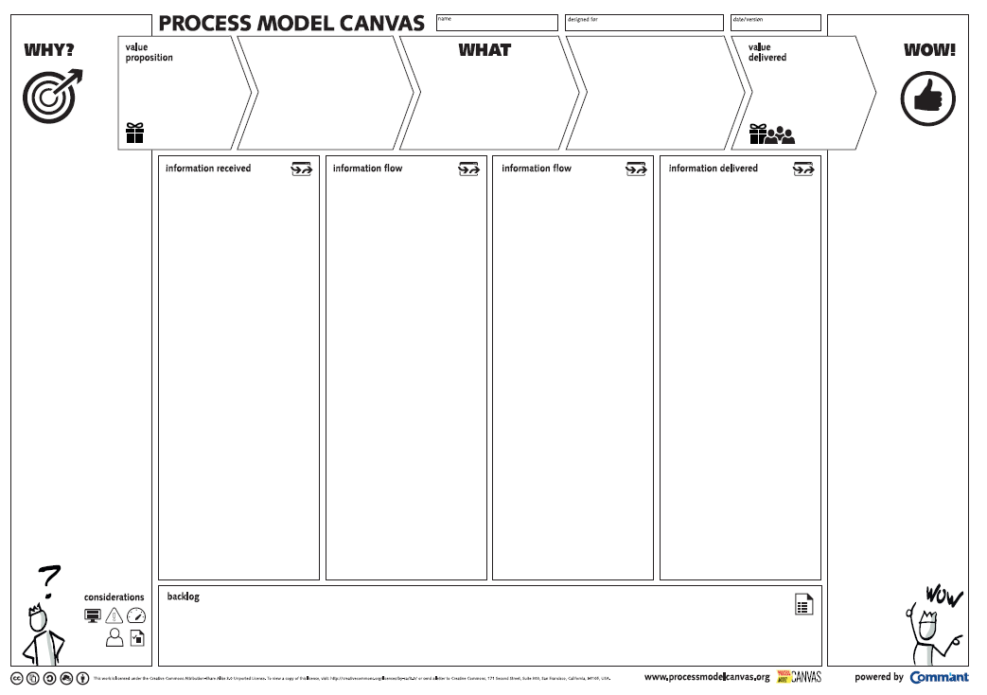
Transformational Methods
Creative: unleashing the creativity of people
Process Model Canvas:
allows firms to reason about the value proposition behind their business processes.

Slide 33
The Redesign Orbit
empty
true transformations hardly emanate from reasoning from an internal perspective only

Slide 34
The Redesign Orbit

Slide 35
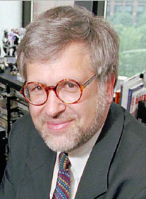
Transformational Methods
Business Process Reengineering
Michael Hammer collected the following insights:
No successful organization relies on piecemeal improvement of what was already carried out. Rather, strong ambition leads to huge rewards
While information technology is a crucial asset in redesigning business processes, it is necessary to go beyond pure automation of what is already being done
Organizations need to break away from a set of ingrained patterns of organizing work that prevent business processes from being carried out in an integrated, cross-functional way

Slide 36
Transformational Methods
Business Process Reengineering
Properties:
The objective is to completely overhaul a process, which puts it in the transformative sphere.
It is analytical because it relies on such a set of clearly defined principles, in contrast to what a group of people comes up with,
It is mostly inward-looking since it still operates within the scope and context of the existing process it aims to overhaul.

Slide 37
Transformational Methods
Business Process Reengineering
Redesign principles:
Make sure that information is captured fresh, at the moment it is produced, and at the source by the stakeholder who is producing it..
Integrate information processing work, i.e., work that involves capturing or processing information, with the real work where this information is produced.
Let those who have an interest in the output of a process not only participate in it but drive it all the way.
Put every decision point in a process preferably at the place where work is performed.

Slide 38
The Redesign Orbit

Slide 39
Transformational Methods
Product-Based Design
Properties:
The objective is to completely overhaul a process, which puts it in the transformative sphere.
It is analytical in nature since it relies on a formal, almost purely algorithmic way of developing a new business process.
It is outward-looking because of the artifact that takes center stage in this method: It is the product that a business process aims to deliver.

Slide 40
Transformational Methods
Product-Based Design
2.
1.
Process
?
Product

Slide 41
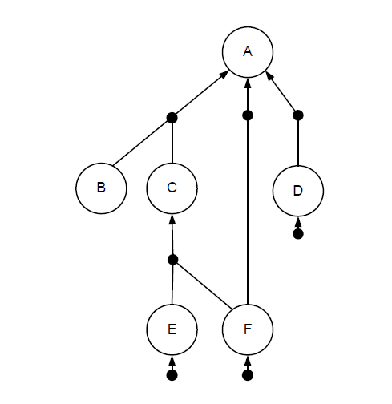
Transformational Methods
Product-Based Design
Product
specifications
Product Data Model
Process

Slide 42
Chapter 8: Process Redesign
Contents
The Essence of Process Redesign
Transactional Methods
Transformational Methods
Recap

Slide 43
Recap
Process redesign can be motivated from a positive and a reactive angle
Process redesign can be understood by considering the different elements of a process:
customers, business process operation, business process behavior, organization structure, organization population, information, technology, and the external
The Devil’s Quadrangle clarifies that many redesign options have to be discussed from the perspective of a trade-off between time, cost, quality, and flexibility
The Redesign Orbit provides a spectrum of redesign methods using three axes:
nature, ambition, and perspective
Redesign methods have their own distinctive characteristics

